Slide 1


Phase contrast
Jerome Mertz

Slide 2
It all starts from this….
F.T.
time
frequency
F.T.
position
(along x)
momentum
(along x)

Slide 3
Fourier transform relationships (diffraction)
λ
Δθ_{x}
large
Δx
small
Δx Δθ_{x} ~ λ/n
Δx
large
Δθ_{x}
small

Slide 4
Fourier transform relationships (diffraction)
λ
Unscattered light
Δx
Δθ_{x}
Scattered light
Δx
Δx Δθ_{x} ~ λ/n

Slide 5
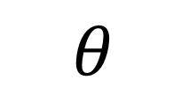
Resolution
Imaging
device
Actual sizes
$$θ$$
Sample

Slide 6
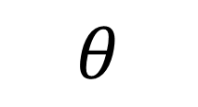
Resolution
Actual sizes
Imaging
device
$$θ$$
Sample

Slide 7
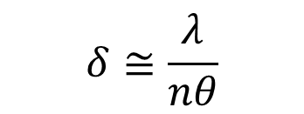
Resolution
Apparent sizes
Imaging
device
$$θ$$
Sample
Minimum apparent size
(a.k.a. Resolution)
$$δ≅\frac{λ}{nθ}$$

Slide 8

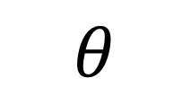
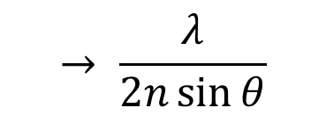
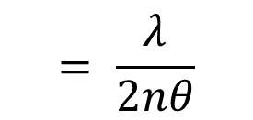
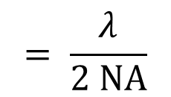
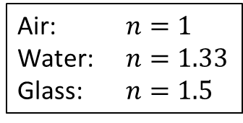
Resolution
Air: $n=1$
Water: $n=1.33$
Glass: $n=1.5$
Apparent sizes
Imaging
device
$$θ$$
1/2
Sample
Minimum apparent size
(aka. Resolution)
$$δ≅\frac{λ}{nθ}$$
$$= \frac{λ}{2nθ}$$
$$→ \frac{λ}{2n\sin{θ}}$$
$$= \frac{λ}{2 NA}$$
1/2
1/2
Numerical aperture →
$$NA=n\sin{θ}$$
1/2

Slide 9
Back to phase….
Absorption
Scattering

Slide 10
Tricks to convert phase to intensity
Zernike phase contrast
Nomarski differential interference contrast (DIC)
Oblique field microscopy

Slide 11
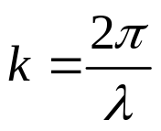


wave-number
n = index of refraction

Slide 12
wave-number
n = index of refraction

Slide 13

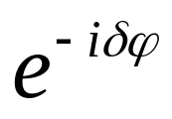

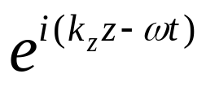
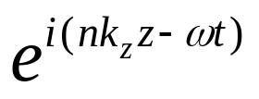

wave-number
phase shift

Slide 14
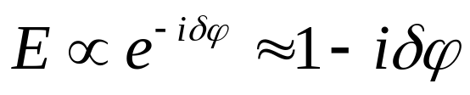
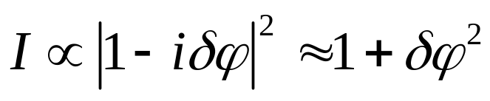
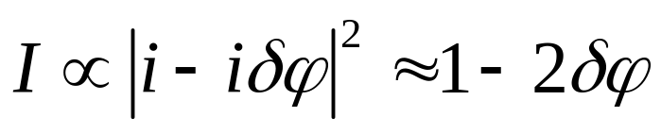
Object
CCD
Imaging system
Born approximation
Field:
ballistic
scattered
Intensity:
← small
What if ballistic field is phase-shifted relative to scattered field?
← not so small

Slide 15

Object
CCD
Imaging system
Δθ_{x}
Rule of thumb:
Δx Δθ_{x} ~ λ/n
(i.e. need high NA to see small structures)

Slide 16

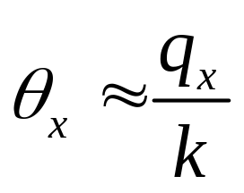
spatial frequency (sample)
wave-number (light)
(i.e. need high NA to see high spatial frequencies)

Slide 17
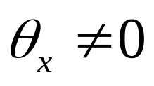
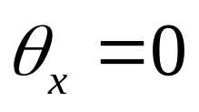
Scattered field
Ballistic field

Slide 18


Object plane
Fourier plane
Image plane
maps angle to position
(conjugate to object plane)
Ballistic
Scattered

Slide 19
Object plane
Fourier plane
Image plane
Ballistic light here
(conjugate to object plane)

Slide 20
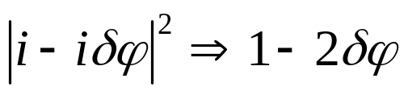
Object plane
Fourier plane
Image plane
Ballistic light here
(conjugate to object plane)
Zernike phase contrast
1) Add π/2 phase shift to ballistic light in Fourier plane:

Slide 21

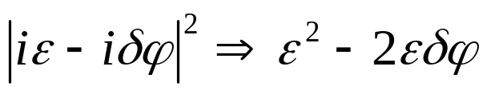
Object plane
Fourier plane
Image plane
Ballistic light here
(conjugate to object plane)
Zernike phase contrast
1) Add π/2 phase shift to ballistic light in Fourier plane:
2) Attenuate ballistic light to improve contrast:
similar in magnitude

Slide 22
Problem !
Illumination must be spatially coherent
Object
Phase plate
Köhler illumination doesn’t work!

Slide 23
Solution:
Köhler illumination
Pinhole
Object
Phase plate
Incoherent (spatially random phases)
Spatially coherent
This solution is not ideal because illumination power is weak

Slide 24
Alternative solution:
Annular illumination
Object
Annular phase-plate
Spatially coherent (sort of)
Advantages of annular illumination:
More illumination throughput
Fewer backreflections from optics
Better resolution (though difficult to interpret)

Slide 25
Alternative solution:
Phase contrast condenser
Phase contrast objective
Annular illumination
Annular phase-plate
Spatially coherent (sort of)
Advantages of annular illumination:
More illumination throughput
Fewer backreflections from optics
Better resolution (though difficult to interpret)

Slide 26
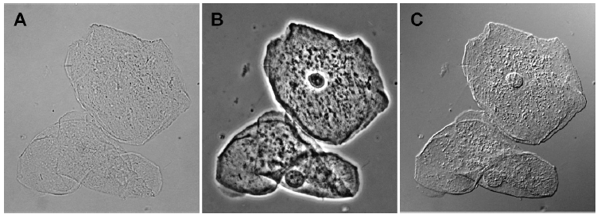
Brightfield
Zernike PC
Nomarski DIC

Slide 27
Tricks to convert phase to intensity
Zernike phase contrast
Nomarski differential interference contrast (DIC)
Oblique field microscopy

Slide 28
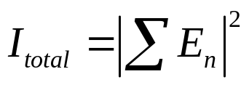


More about phase…
Well-defined phases
Fields add
Intensities add
Random phases
Intensities add
Cross-polarized

Slide 29


…and polarization
Wollaston prism
Polarizer
Polarizing beamsplitter
Nomarski prism
mrad

Slide 30
In phase, equal amplitude
=
Linear polarization 45º
In phase, unequal amplitude
=
Linear polarization
Out of phase, equal amplitude
=
or
Circular polarization
Elliptic polarization

Slide 31

Transparent sample
CCD
Spatially coherent illumination
(polarization 45º)
Nomarski

Slide 32
Transparent sample
CCD
Spatially coherent illumination
(polarization 45º)
Nomarski
Polarizer -45º
(analyzer)

Slide 33

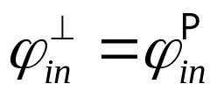
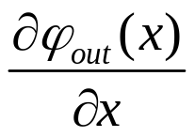
Scattering sample
CCD
Spatially coherent illumination
(polarization 45º)
Nomarski
Key condition:
Polarizer -45º
(analyzer)
phase shifted
Sensitive to phase gradient
Problem: how to get bright coherent illumination with a lamp?

Slide 34
Polarized Köhler illumination?
Scattering sample
lamp
CCD
Nomarski
Polarizer +45º
Polarizer -45º
(analyzer)

Slide 35
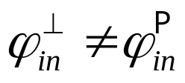
Polarized Köhler illumination?
Scattering sample
lamp
CCD
Nomarski
Polarizer +45º
Polarizer -45º
(analyzer)
Random phases:
Doesn’t work because Köhler illumination not spatially coherent

Slide 36
Trick: DIC microscopy
Scattering sample
lamp
CCD
Nomarski
Nomarski
Polarizer +45º
Polarizer -45º
(analyzer)
Pairwise correlated:
Polarized Köhler illumination with Nomarski prism provides bright uniform illumination that is locally pairwise coherent

Slide 37










DIC illumination
Köhler illumination
(spatially incoherent and unpolarized)
⁺
Polarizer 45º

Slide 38

DIC illumination
Pairwise coherent
Köhler illumination
(spatially incoherent and unpolarized)
⁺
Polarizer 45º
⁺
Nomarski prism

Slide 39
Trick: DIC microscopy
Scattering sample
lamp
CCD
Nomarski
Nomarski
Polarizer +45º
Polarizer -45º
(analyzer)
Pairwise correlated:
Polarized Köhler illumination with Nomarski prism provides bright uniform illumination that is locally pairwise coherent

Slide 40
Brightfield
Zernike PC
Nomarski DIC

Slide 41
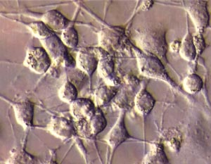
Very useful in neuroscience

Slide 42
Tricks to convert phase to intensity
Zernike phase contrast
Nomarski differential interference contrast (DIC)
Oblique field microscopy

Slide 43
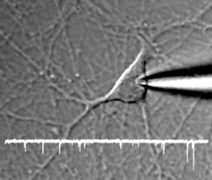


But there’s a problem….
Phase contrast
Transmission
geometry
Thin slice

Slide 44
?
Reflection
geometry
Phase contrast
Thick tissue

Slide 45
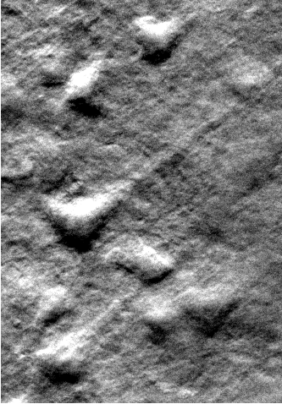
Oblique back-illumination microscopy (OBM)
To camera
LED
LED
Thick mouse brain slab
(depth ≈50µm)

Slide 46
OBM microendoscopy
LED
Camera
LED
2 shots per frame
70µm working distance
Tissue

Slide 47
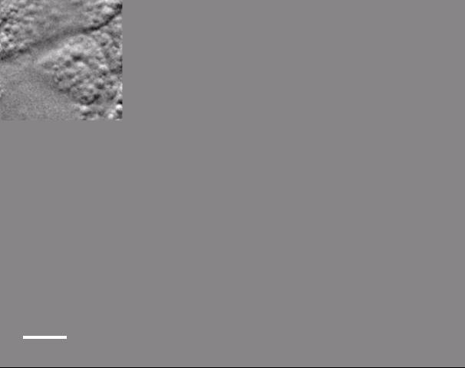
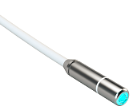
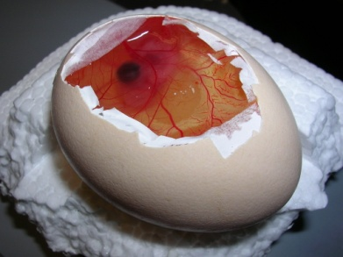
OBM with microendoscope (chick embryo)
30,000 fibers
3mm
Mauna-Kea Technology
80 µm

Slide 48
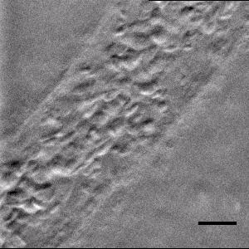
OBM with microendoscope (chick embryo)
30,000 fibers
3mm
Mauna-Kea Technology
30μm
Frame rate: 25 Hz

Slide 49
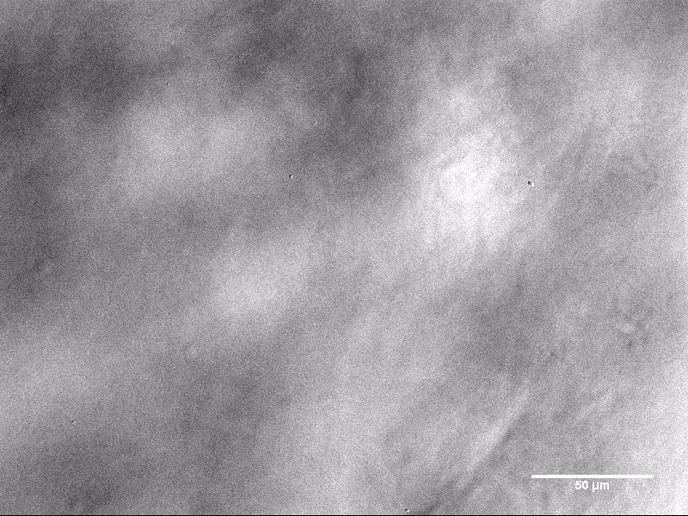
Mouse skin tissue
(microscope configuration)

Slide 50
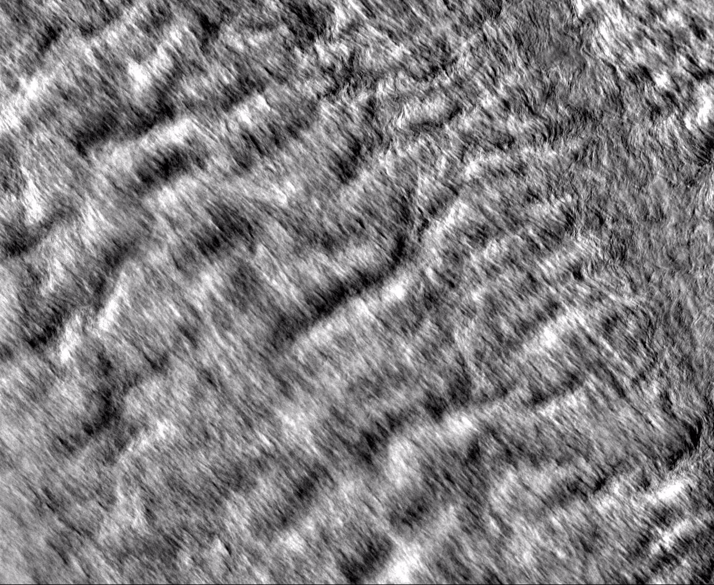
Cow trachea

Slide 51
How does it work?
Aperture
Oblique illumination

Slide 52
How does it work?
Aperture
Oblique illumination

Slide 53
How does it work?
Aperture
Oblique illumination

Slide 54
How does it work?
Aperture
Oblique illumination

Slide 55
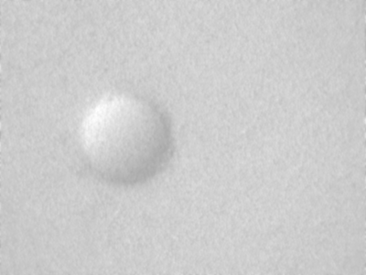
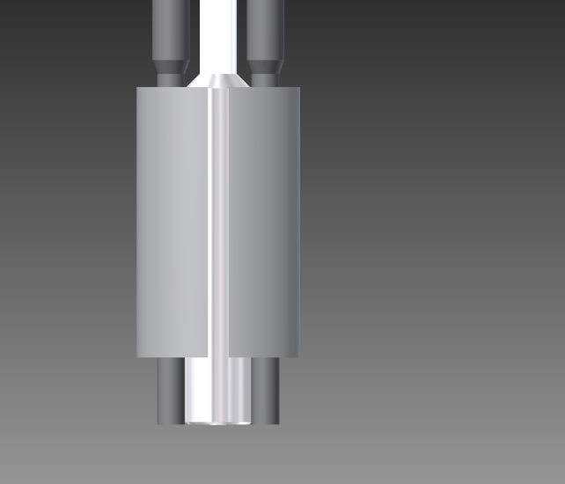
LEFT
45μm bead
Scattering phantom:
2μm beads mixed in
1cm thick agarose gel
l_{s} = 75μm ; l_{s}* ≅ 1mm

Slide 56
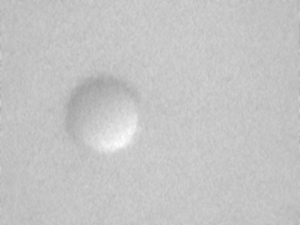
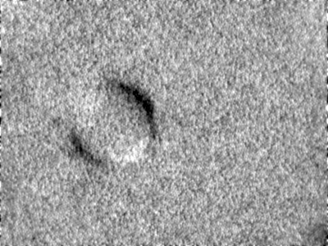
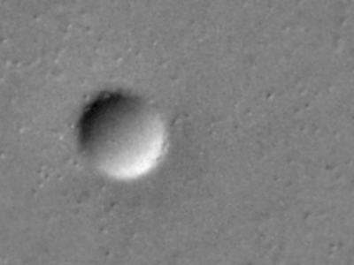
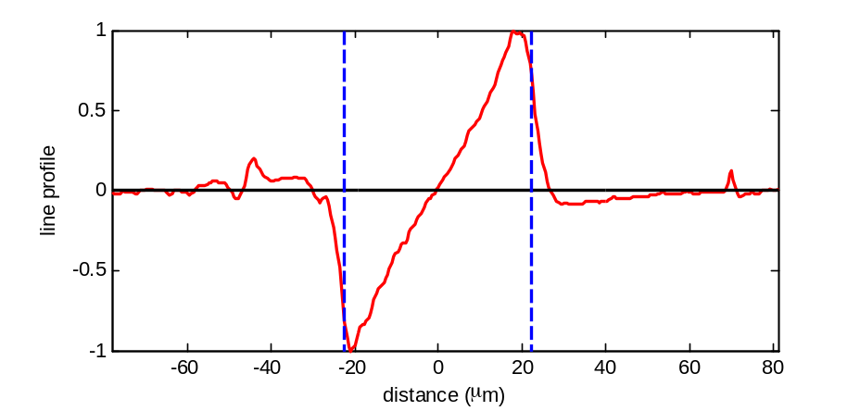
LEFT
RIGHT
SUM
DIFFERENCE
45μm bead
Scattering phantom:
2μm beads mixed in
1cm thick agarose gel
l_{s} = 75μm ; l_{s}* ≅ 1mm

Slide 57
Comparison OCT and OBM
(Mouse flank skin)
En-face OCT
OBM
Image acquired by Light-CT Scanner,
LLTech (Paris)

Slide 58
an aside…

Slide 59
Principle of reciprocity
Widefield microscope
Source
Array detector
Scanning microscope
Large area detector
Scanning source

Slide 60
Principle of reciprocity
Widefield microscope
Source
Array detector
Scanning microscope
Large area detector
Scanning source

Slide 61
Principle of reciprocity
Widefield microscope
Source
Array detector
Scanning microscope
Large area detector
Scanning source

Slide 62
Principle of reciprocity
OBM
Scanning OBM
To camera
From laser
LED
Phase gradient
|
LED
+
equivalent
Amplitude
If this works…
then this must also work

Slide 63
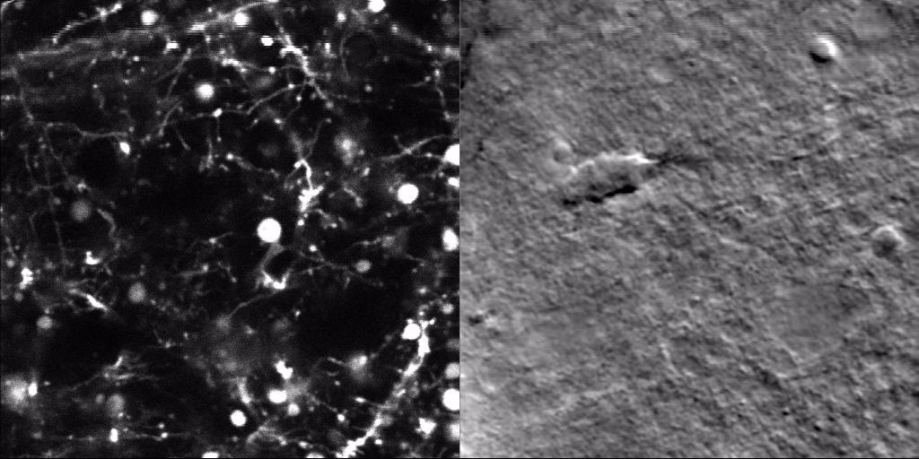
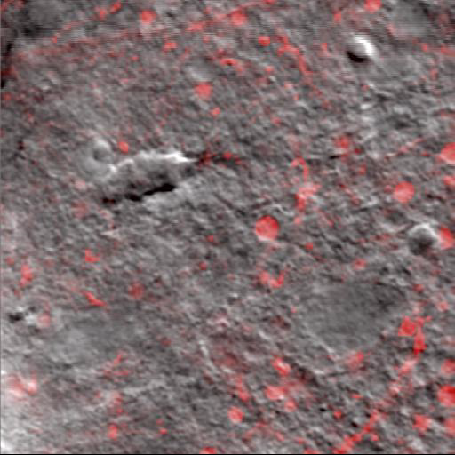
Scanning OBM with TPEF
TPEF
sOBM
GFP-labeled mouse cortex
FOV = 80μm
depth →
Davison Lab, Boston University

Slide 64
Scanning OBM with CARS
CARS
sOBM
Rat sciatic nerve
FOV = 80μm
Coté Lab, University Laval

Slide 65
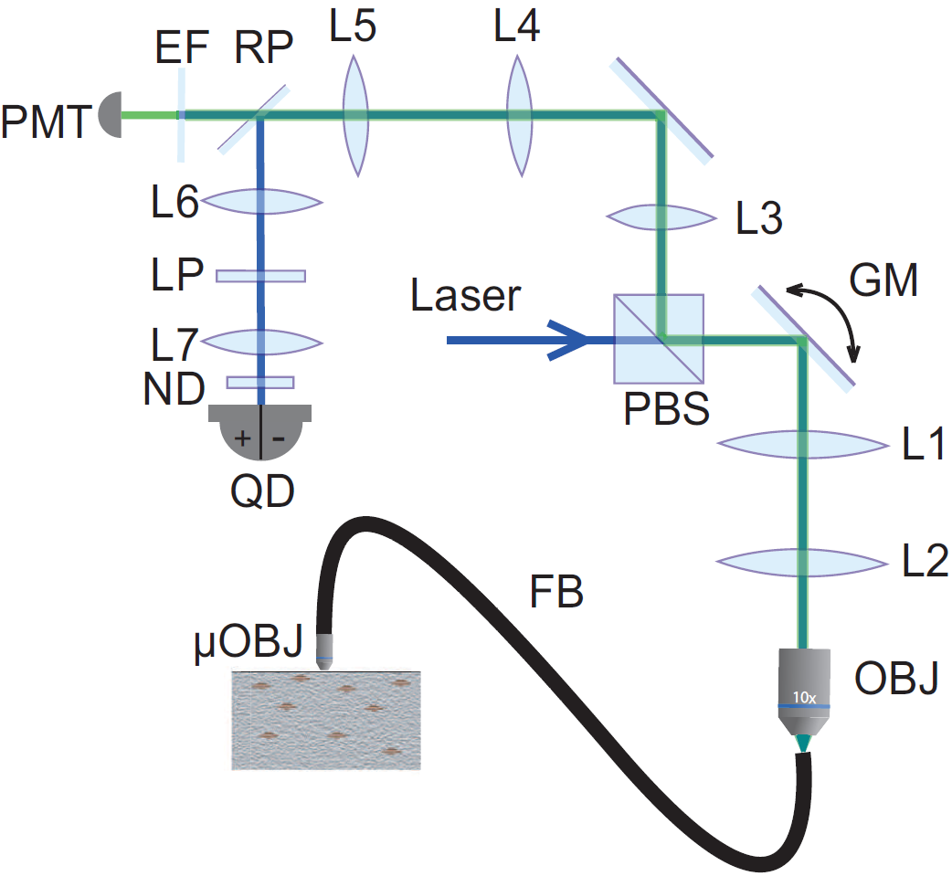
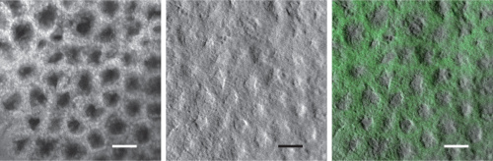
Endomicroscopy (Scanning confocal microscopy)
Pinhole
Fluorescence
Mouse colon epithelium
30,000 fibers
2.8mm
…in collaboration with Ritt Lab

Slide 66
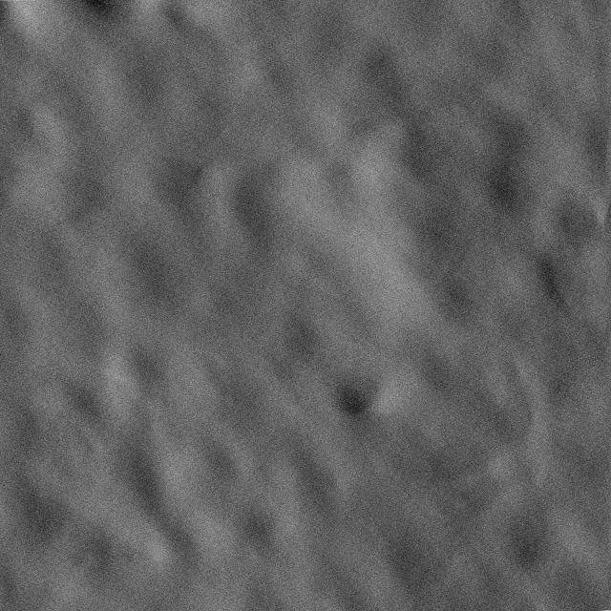
Endomicroscopy (Fluorescence + Phase)
Reflecting
pinhole
Fluorescence
Phase
Mouse colon epithelium
Combined
30,000 fibers
2.8mm
…in collaboration with Ritt Lab

