Slide 1
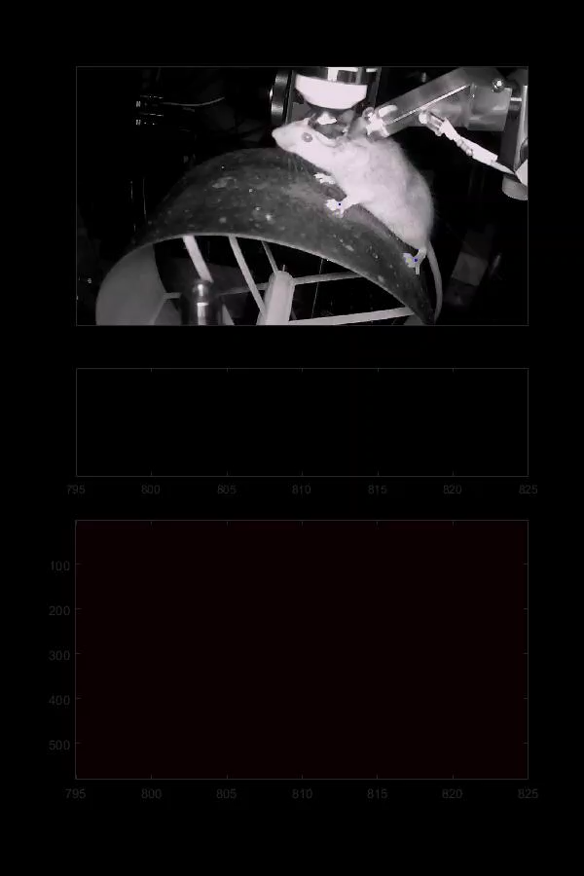
Paw (?) related (?) signals (?) in S1 (?)
Andrew Erskine – CSHL imaging 2019

Slide 2
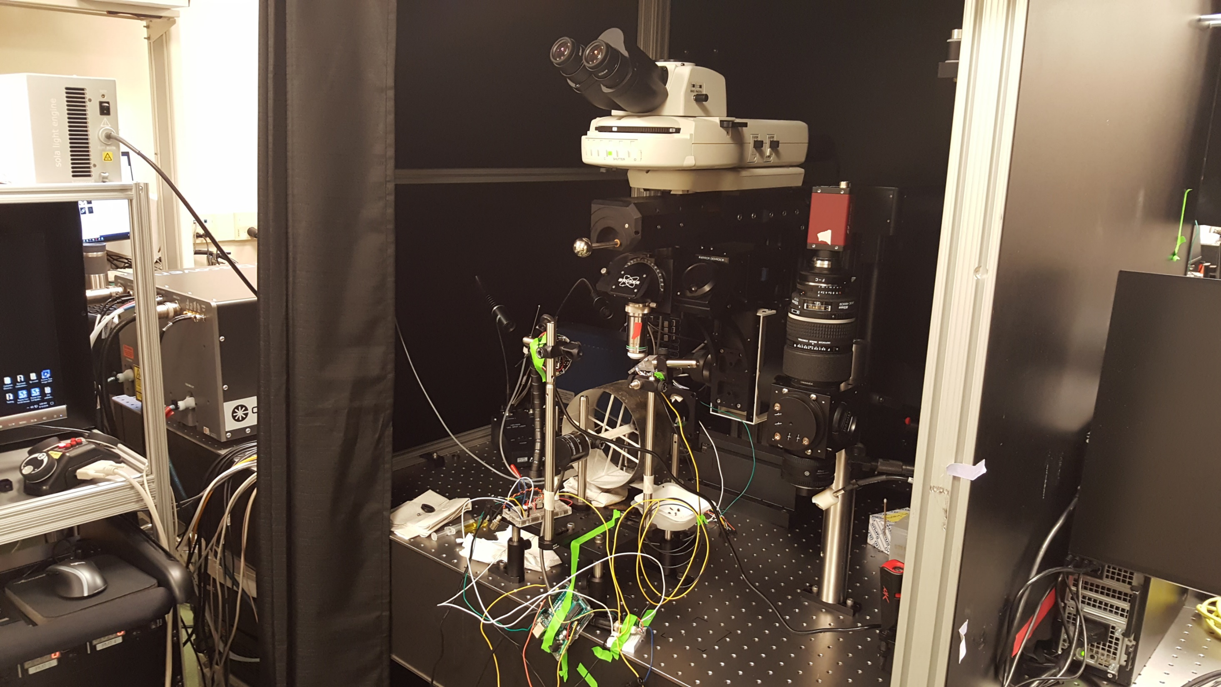
Experiment
Wide-field + Bruker 2p
Head-fixed awake animal, running wheel
4mm cranial window over V1, S1
GCaMP6s
2p synchronized to rotary encoder, IR camera (Bonsai), LED visual stimulus (Arduino)
Recordings in putative L2/3, 4 in S1 and V1
https://bonsai-rx.org/

Slide 3
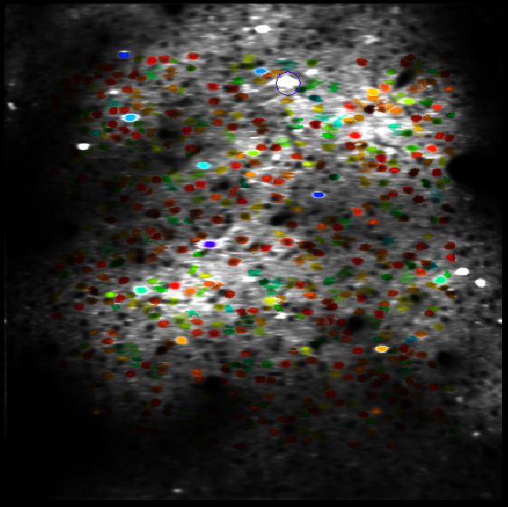
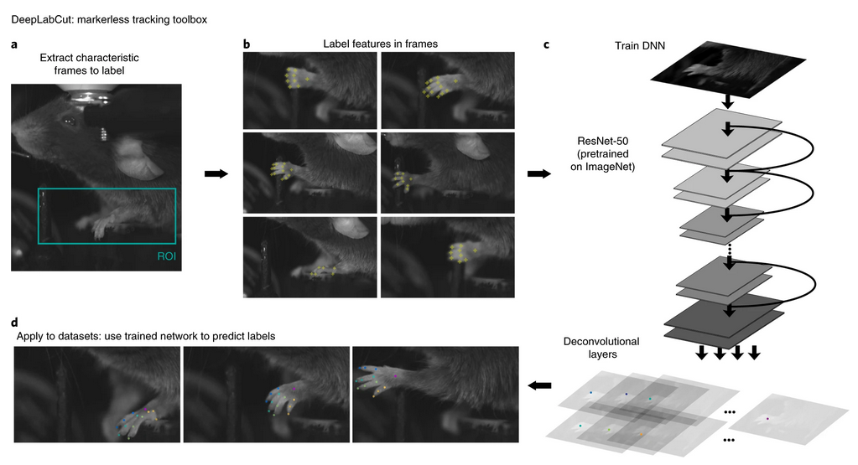
Analysis
Suite2p fluorescence extraction
DeepLabCut for tracking paw pose
  ~300 manually labeled frames → ~60,000 tracked frames
Pachitariu et al., 2017; Mathis et al., 2018

Slide 4
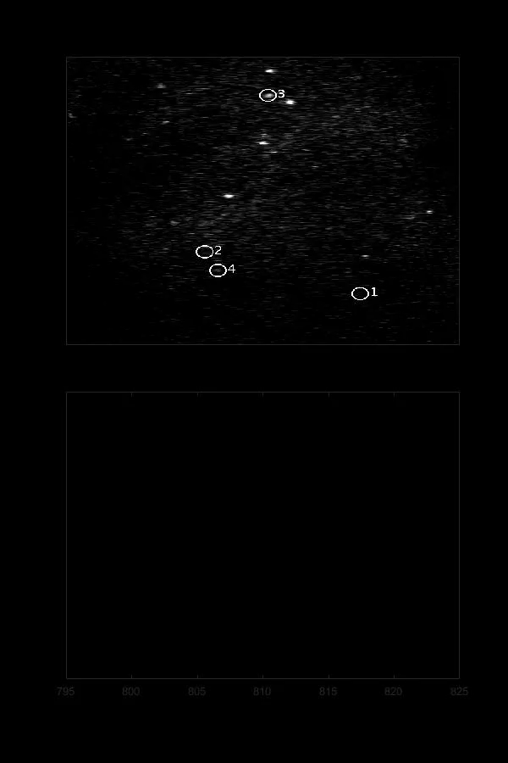
z-score: 7

Slide 5
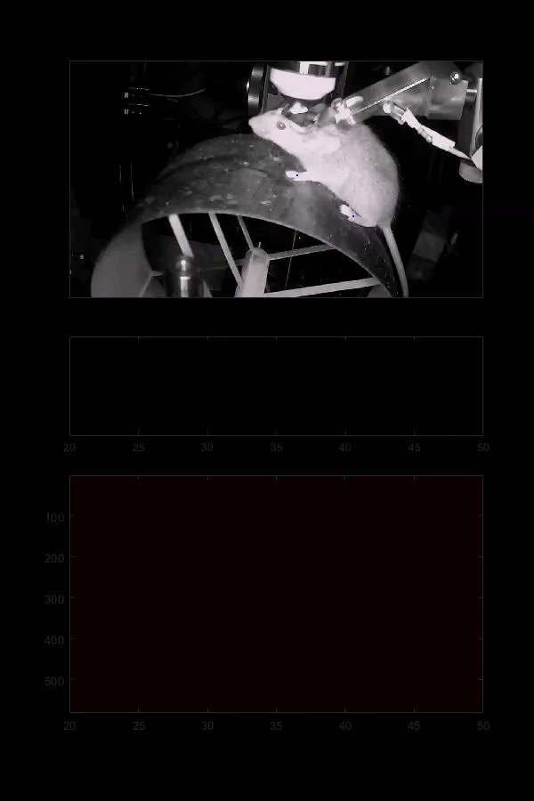
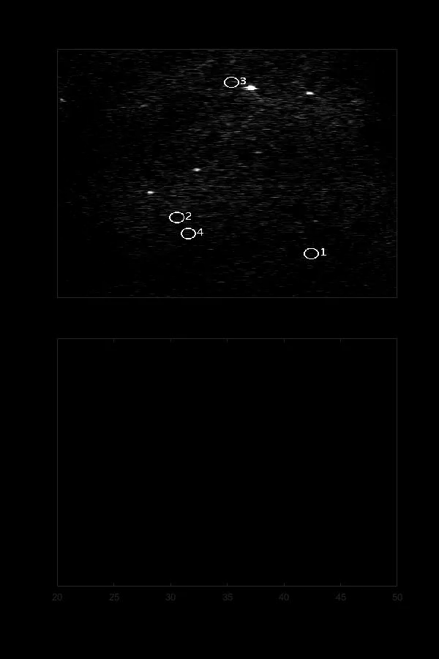

Slide 6
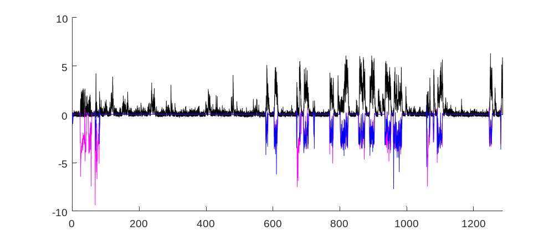
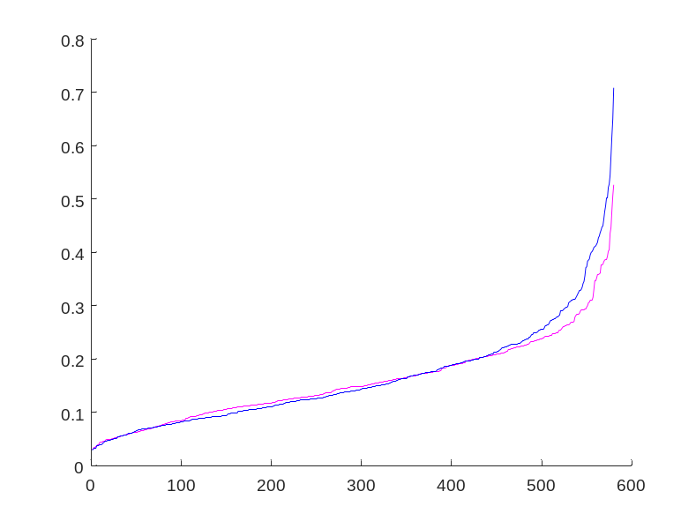
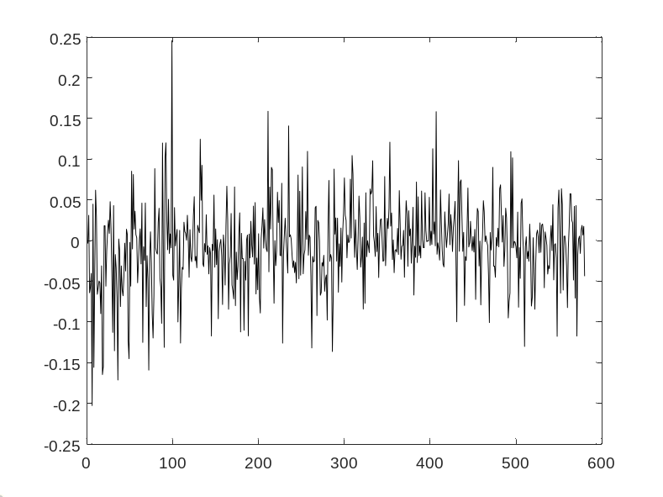
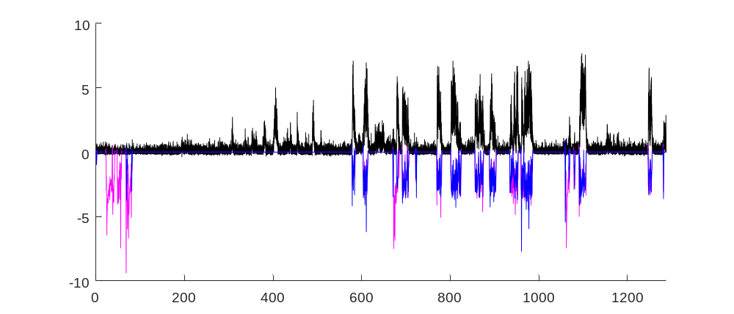
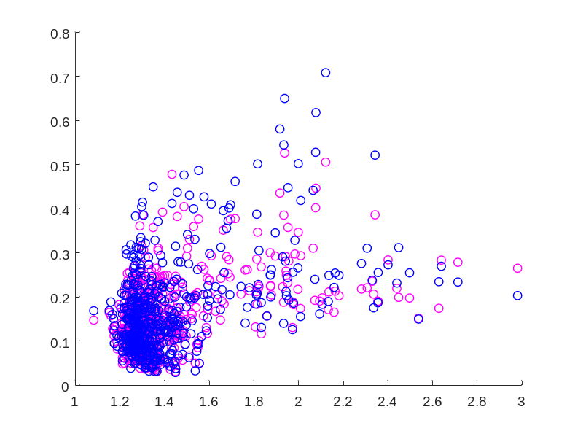
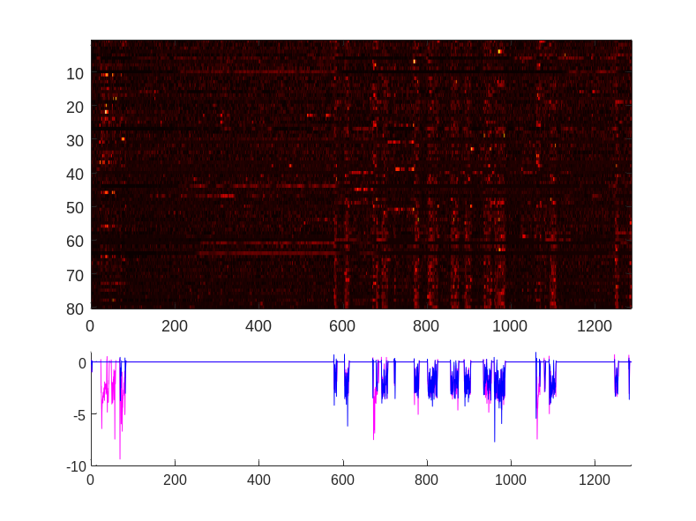
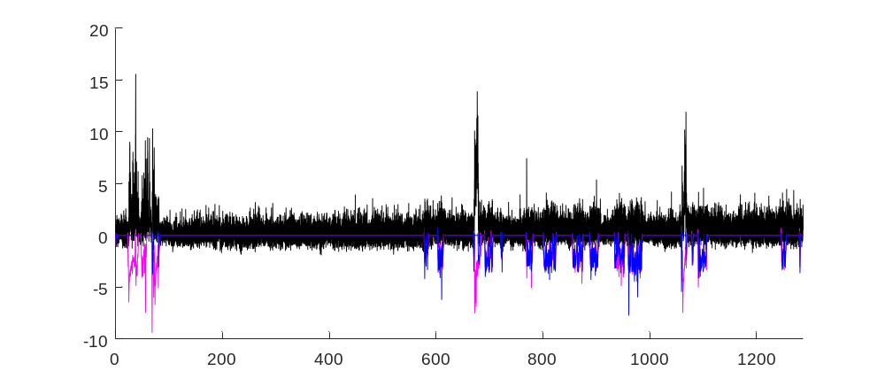
Front paw
Hind paw
Max. cross-correlation coefficient
Front coef. – Hind coef.
Sorted ROI
Sorted ROI
F z-score / Front paw Hz / Hind paw Hz
R = 0.43***
R = 0.42***
ROI
Max. cross-correlation coefficient
Paw Hz
Time (s)
Mean F z-score above baseline
Time (s)

